Slide 1
Unitesh Country State Wise Poppulation
File created on: 9/23/2024 6:20:39 AM

Slide 2
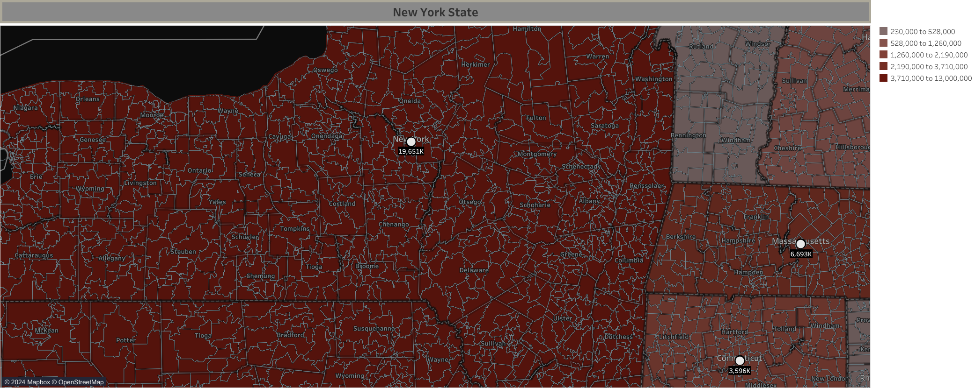

Slide 3
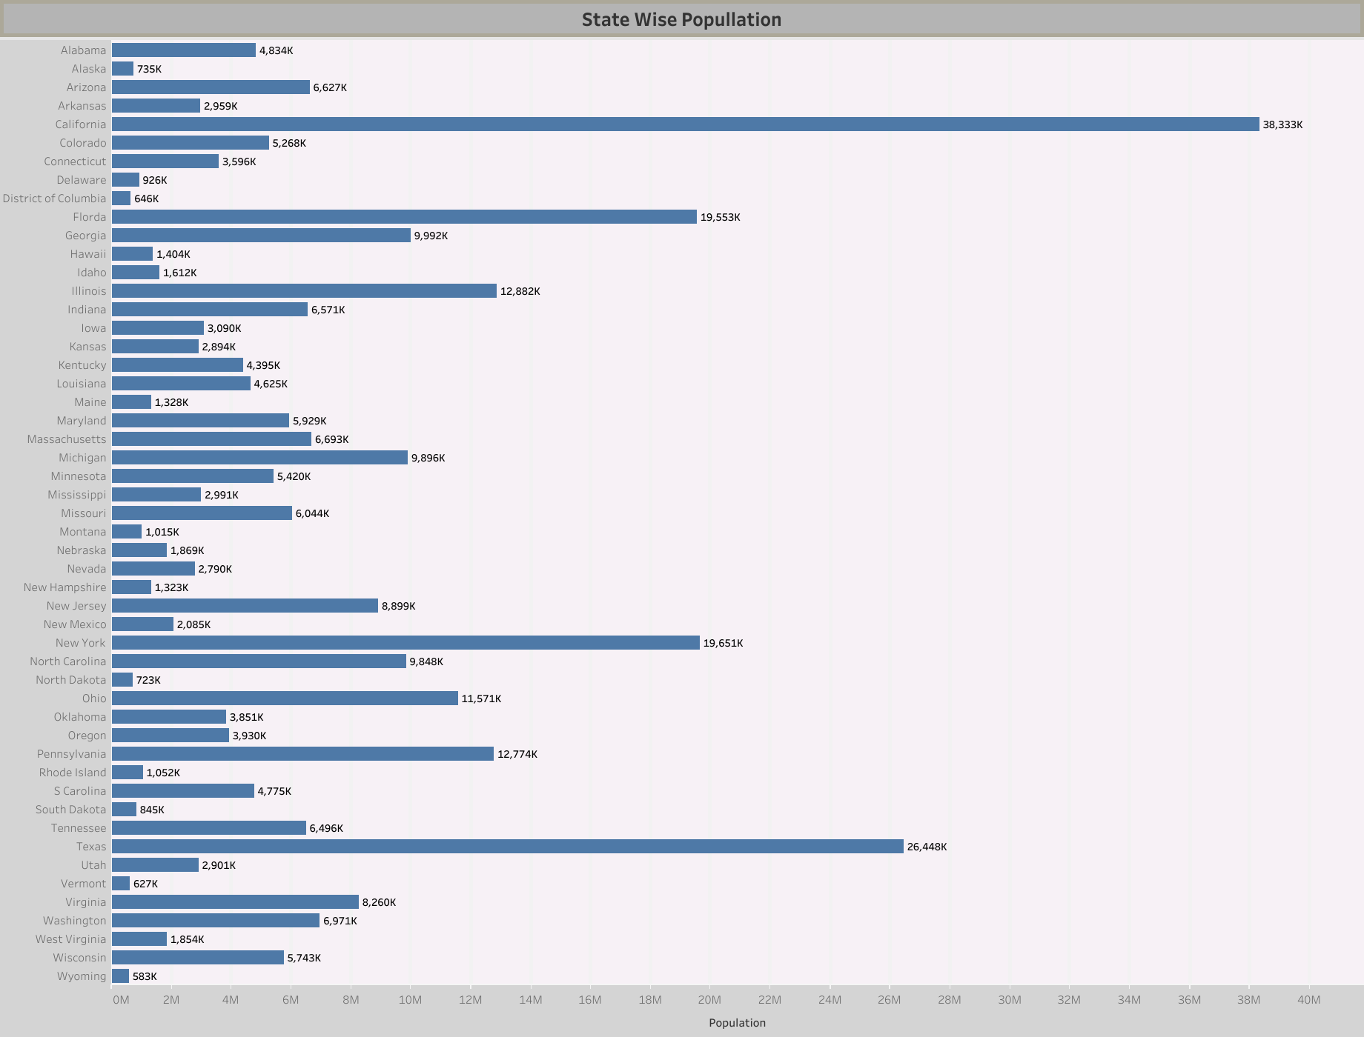

Slide 4
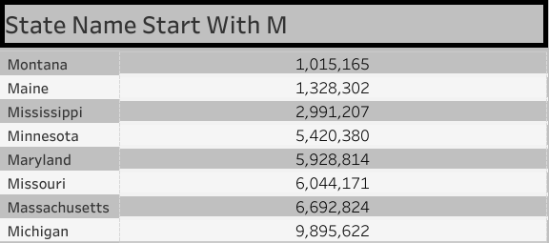

Slide 5
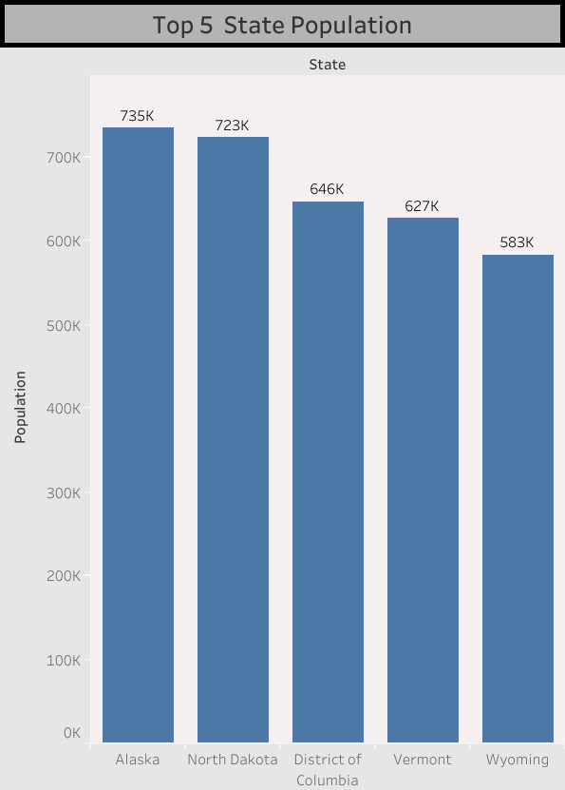

Slide 6


